Slide 1



NRC OCIO Customer eXperience Overview
2021 Government UX Summit June 2021

Slide 2




1
Our Bottom Line
By applying a data-driven approach to drive our targeted outcomes, the NRC Customer experience team aims to enhance IT services for our customers and align with our core objectives for NRC IT Transformation.
TRANSFORM SERVICE DELIVERY
LEVERAGE TECHNOLOGY TO CONDUCT WORK
FOCUS ON CULTURE TO ENHANCE WORK
Manage IT Service Delivery to meet evolving needs of the customers
Innovate how we work through new tools and technologies
Promote a customer-centric culture to improve how we operate

Slide 3
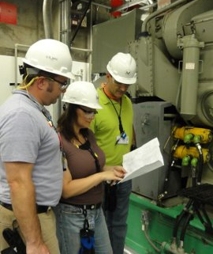
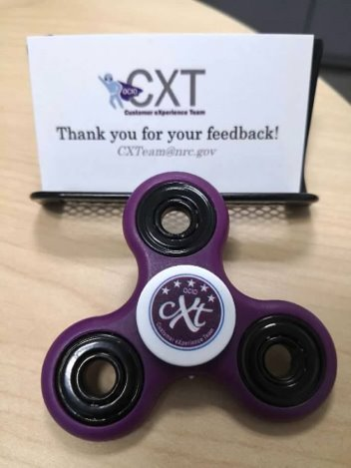
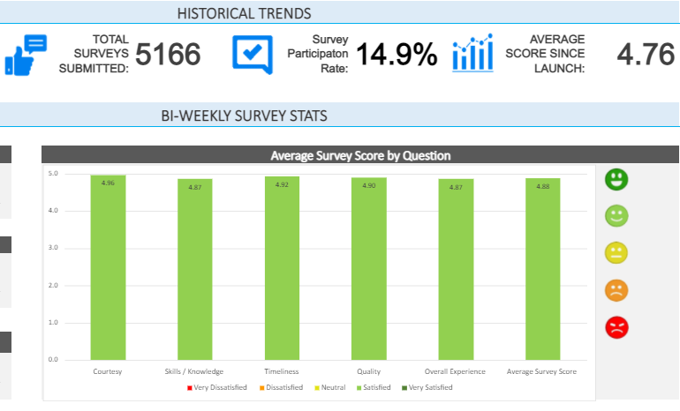
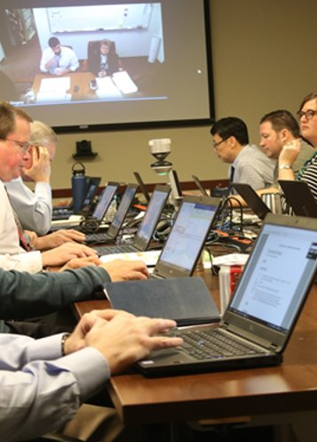
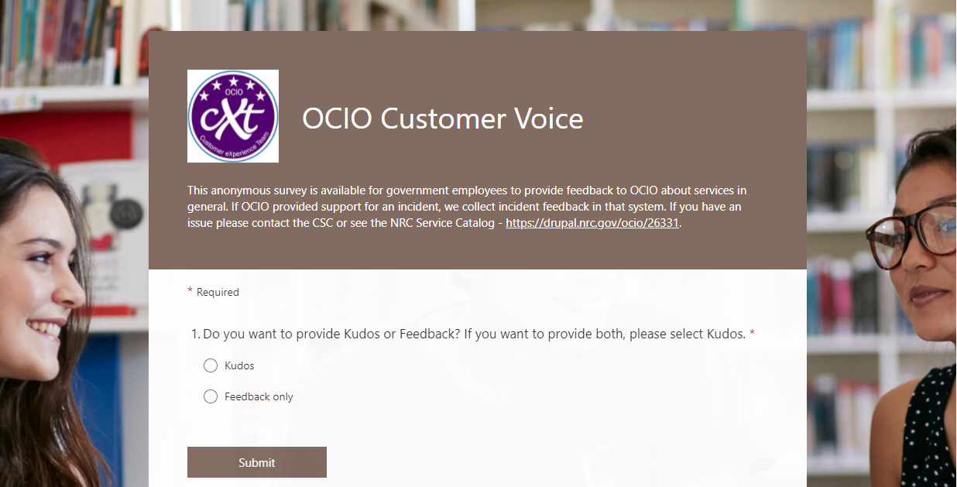
Establishing a Customer-Centric Culture at NRC (1)
How did NRC adapt to a new culture and attitude to enhance the customer experience?
In 2018, we established the CX team by defining our core team members, advisory board, and governance structure.
To promote the Customer eXperience team across NRC, our team built out the CX brand.
To better understand customer needs, we created various feedback tools and channels to capture the customer perspective.
2

Slide 4
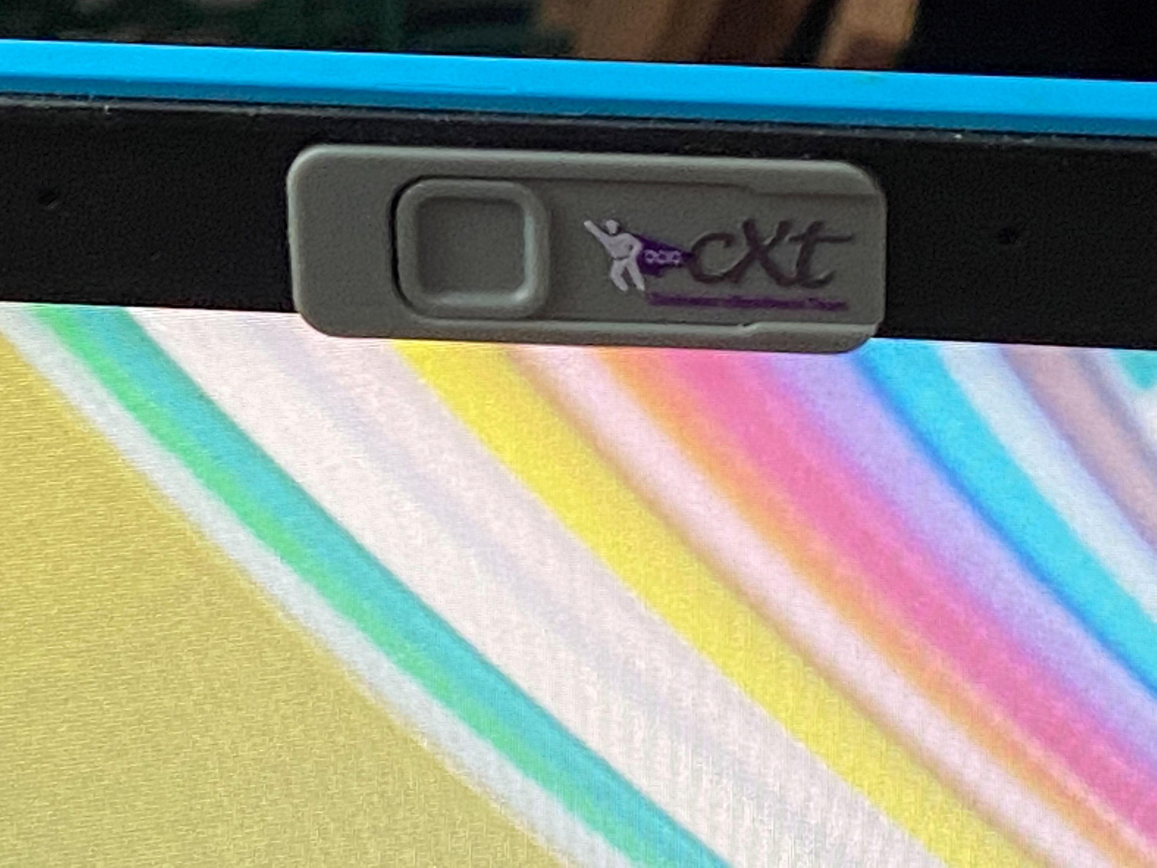
Establishing a Customer-Centric Culture at NRC (2)
How did NRC adapt to a new culture and attitude to enhance the customer experience?
Fun fact: when the CX team developed our customer “swag” we initially chose webcam covers and learned some lessons once we had handed these out to customers!
In 2018, we established the CX team by defining our core team members, advisory board, and governance structure.
To promote the Customer eXperience team across NRC, our team built out the CX brand.
To better understand customer needs, we created various feedback tools and channels to capture the customer perspective.
3

Slide 5


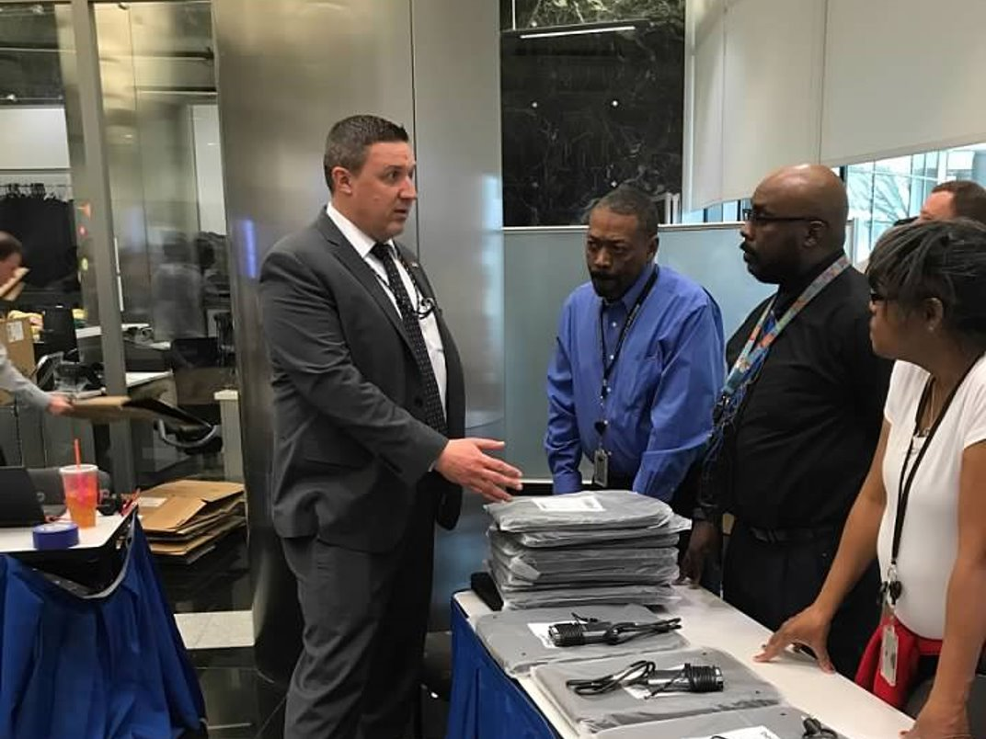
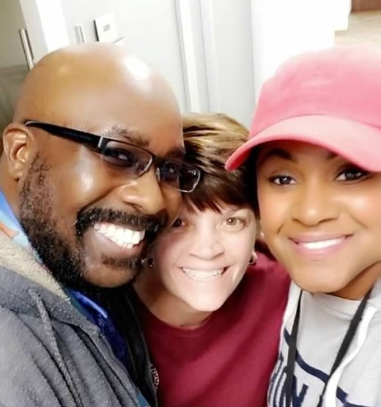

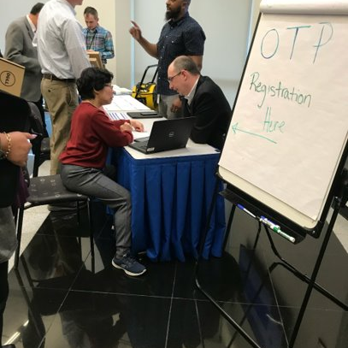

Adapting to the New Norm
How did NRC quickly respond to the COVID-19 crisis and reshape how we operate?
Being well positioned for telework prior to COVID made the transition seamless.
Providing ongoing support and communications with customers kept us connected.
Hosting trainings and sharing tech tips keeps customers in the know.
4

